Slide 1

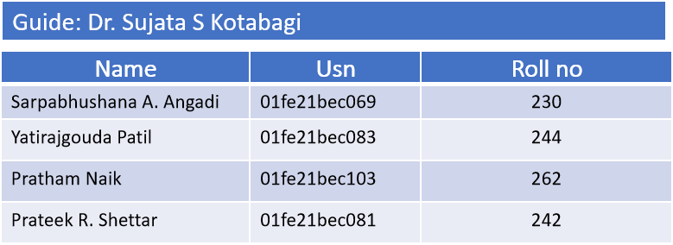
Course: Minor project
Semester: VI
Team number: 08
3/18/23
School of ECE
1

Slide 2

Title: Current steering DAC
Contents
Introduction to DAC
DAC parameters
DAC architectures
Literature survey
Initial implementation
Final implementation
Conclusion
3/18/23
School of ECE

Slide 3
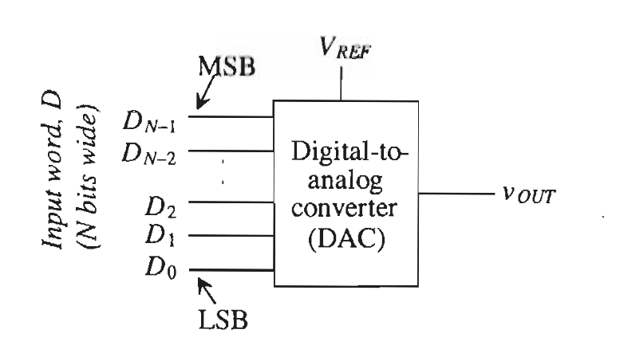
Title: Current steering DAC
Digital to Analog Converters (DAC)
It converts Digital signal into Analog signal.
Probably the most popular digital-to-analog converter application is the digital audio compact disc player. Here digital information stored on the CD is converted Into music via a high-precision DAC. Many characteristics define a DAC's performance.
It should be noted that DACs and ADCs can use either voltage or current as their analog signal. For purpose of describing specifications, it Will be assumed that the analog signal is a voltage.
A block diagram of a DAC can be seen in below fig.
3/18/23
School of ECE
3

Slide 4
DAC parameters
Title: Current steering DAC
1. LSB
2. MSB
3. Differential Non linearity(DNL)
4. Integral Nonlinearity(INL)
5. Offset
6. Gain error
7. Latency
8. Signal to noise ratio(SNR)
9. Dynamic range
3/18/23
School of ECE

Slide 5
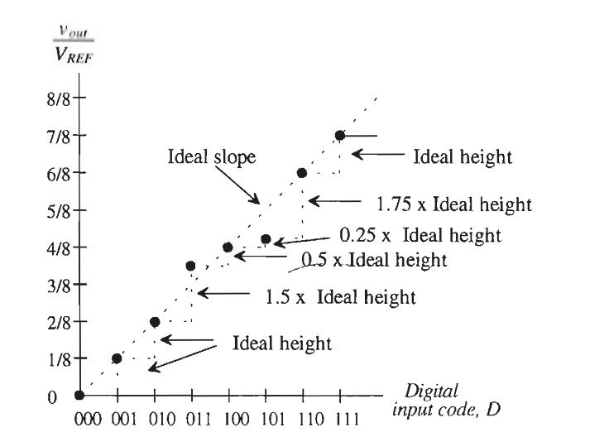
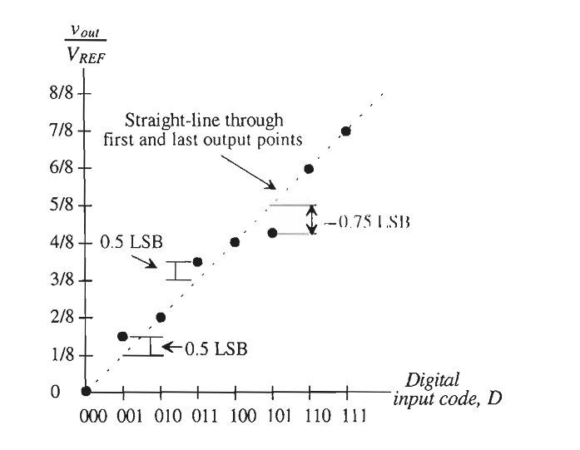
Title: Current steering DAC
DNL INL
3/18/23
School of ECE

Slide 6
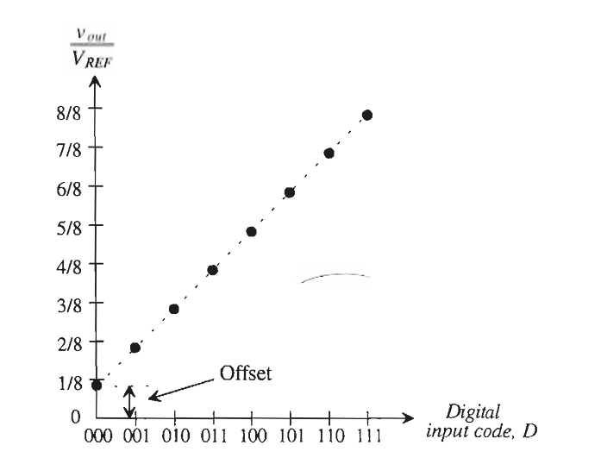
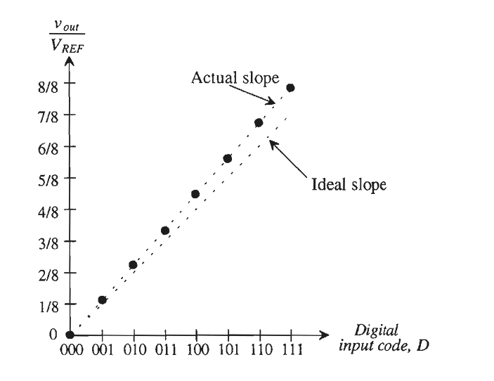
Title: Current steering DAC
Offset Error Gain error
3/18/23
School of ECE

Slide 7
DAC Architectures(Driving principles)
Title: Current steering DAC
Voltage division
Charge scaling
Current steering
Interpolating DAC
Segmented DAC
Pulse Width Modulation (PWM) DAC
Sigma-Delta DAC
String DAC (String Resistor Network)
R-2R Ladder DAC
3/18/23
School of ECE

Slide 8
Title: Current steering DAC
Current Steering:
Principle: Current steering DACs steer current through different paths to generate the output voltage. They often utilize switching elements such as transistors to direct current flow.
Operation: By controlling the switching of current sources, the DAC can generate an analog output voltage corresponding to the digital input code.
Example: The binary-weighted current steering DAC.
Charge Scaling:
Principle: Charge scaling DACs operate by charging capacitors with different amounts of charge to represent digital codes. The analog output voltage is generated by summing the charges stored on these capacitors.
Operation: Each capacitor represents a bit in the digital input code. Charging or discharging these capacitors according to the digital input creates a voltage proportional to the digital code.
Example: The binary-weighted capacitor DAC.
3/18/23
School of ECE

Slide 9
Title: Current steering DAC
Segmented DAC:
Principle: Divide the analog input range into segments and utilize different conversion techniques or architectures for each segment. This approach improves performance by tailoring the conversion method to specific input ranges.
Operation: The DAC dynamically selects the appropriate conversion method based on the input range to optimize performance.
Example: A segmented DAC might use a combination of voltage division, charge scaling, and current steering in different segments.
Sigma-Delta DAC:
Principle: Utilize oversampling and noise shaping techniques to achieve high-resolution conversion. They quantize the difference between the input signal and a feedback signal at a high sampling rate.
Operation: Sigma-Delta DACs use a feedback loop to suppress quantization noise, allowing for high-resolution conversion with relatively low-resolution internal DAC elements.
Example: Sigma-Delta DACs are commonly used in audio and instrumentation applications where high resolution and low noise are critical.
3/18/23
School of ECE

Slide 10
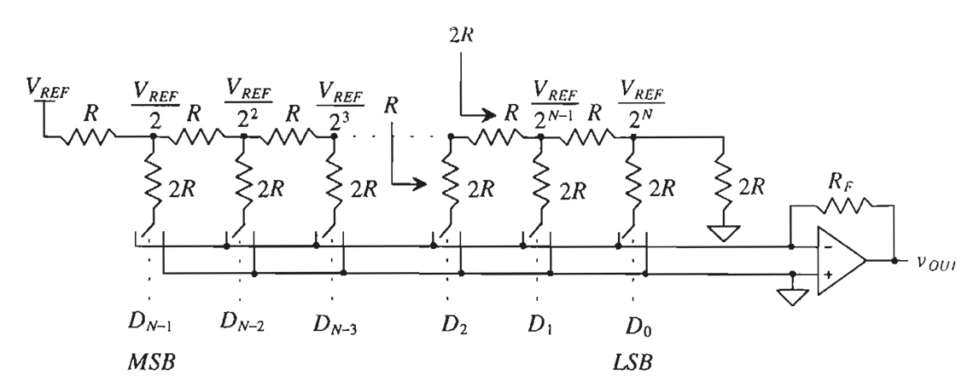
Title: Current steering DAC
R -2R Ladder Networks :
It is a network of resistors alternating in value of R and 2R.
3/18/23
School of ECE

Slide 11
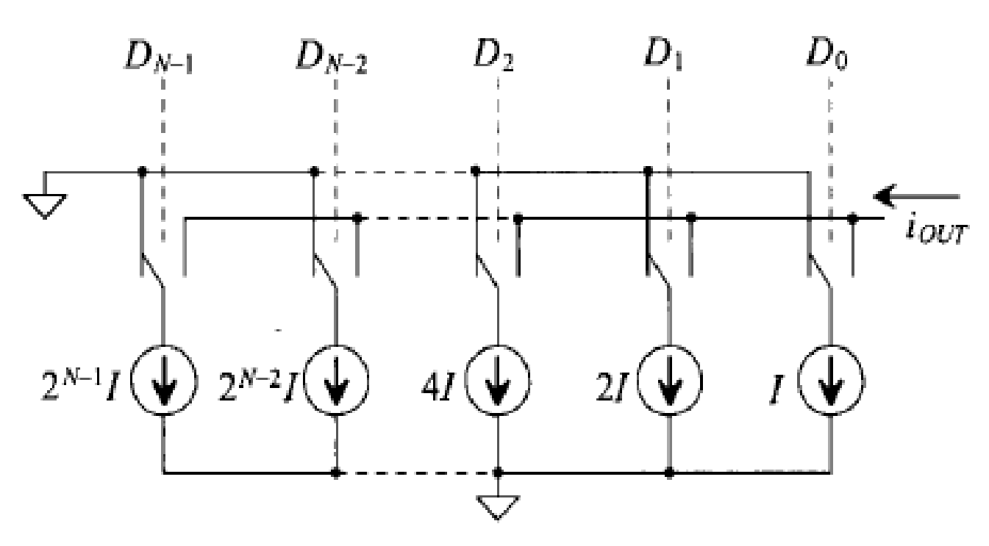
Title: Current steering DAC
Current steering DAC :
This type of DAC method uses current throughout the conversion. Known as current steering, this type of DAC requires precision current sources that are summed in various fashions.
3/18/23
School of ECE

Slide 12
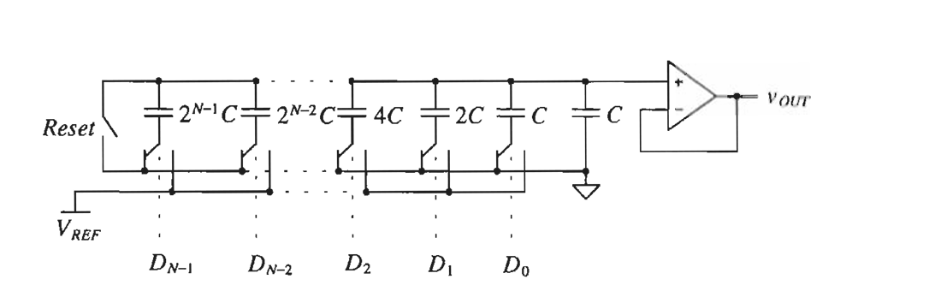
Title: Current steering DAC
Charge Scaling DACs :
A very popular DAC architecture used in CMOS technology is the charge scaling DAC. A parallel array of binary-weighted capacitors, totaling 2^N C, is connected to an op-amp.
3/18/23
School of ECE

Slide 13
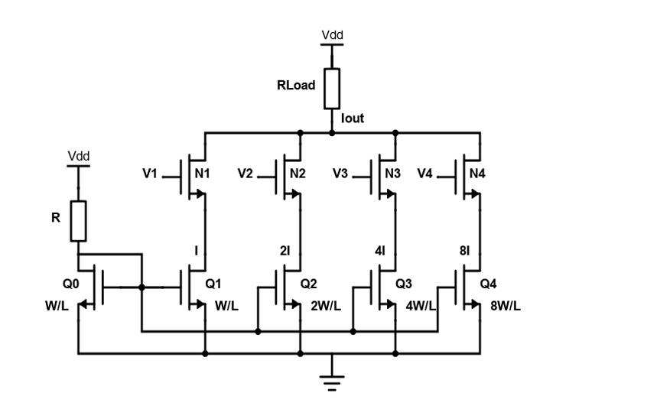
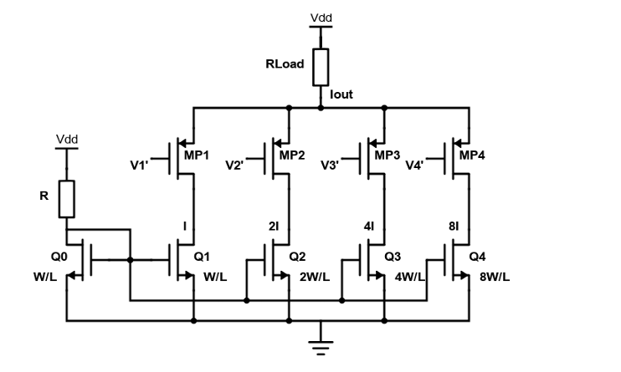
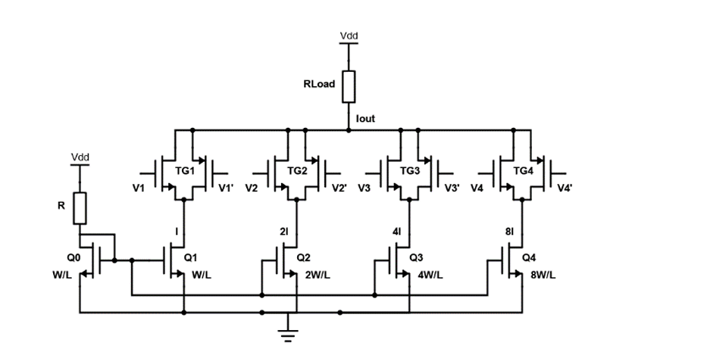
Title: Current steering DAC
Different Architectures of binary weighted current steering DAC
Fig.1 CS-DAC with NMOS switches
Fig. CS-DAC with PMOS switches
Fig 3. CS-DAC with transmission gate switches
3/18/23
School of ECE

Slide 14
Title: Current steering DAC
Comparison between all DAC Architectures :
Compared to all above explained DACs, Current steering DAC is faster and low power consuming.
Current steering DACs generate an output current rather than a voltage. This output current is typically provided by an array of current sources controlled by the digital input code. Since current sources ideally have infinite output impedance, the output impedance of the DAC is primarily determined by the matching of these current sources.
The Current steering DACs are the more commonly used architecture because of their small size and simplicity, high resolution and high speed.
In the 4-bit DAC, four binary weighted current sources are used, those are represented as: Io, 2Io, 4Io and 8Io. The main advantage of this architecture is number of current cells required will be same as no. of bits. Hence, this architecture is most suitable for higher resolution implementations.
The disadvantage with this architecture: it produces number of glitches (unwanted signal) on the contrary the unary architecture offers higher accuracy with greater linearity at the cost of chip area and power overhead
3/18/23
School of ECE

Slide 15
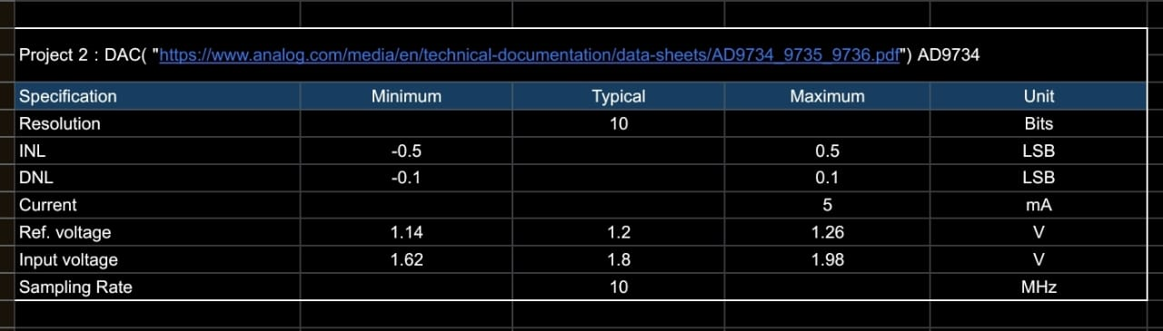
Title: Current steering DAC
Specifications :
3/18/23
School of ECE

Slide 16
Literature survey :
Title: Current steering DAC
[1]. An 8 Bit Binary Weighted CMOS Current Steering DAC Using UMC 180nm Technology
An 8 bit digital to analog converter, which works on the basis of weighted current sources.
A current reference with 3.2µA reference current is designed for getting binary weighted current sources and to bias the buffer.
The currents corresponding to high bits of digitalinput are added using a resistor and the hence obtainedvoltage is buffered at the output to make the output loadindependent.
The measured integral non-linearity lies between 0.6LSB and -0.6LSB with respect to best fit transfer curve. and the measured differential non-linearity is better than 0.8LSB.
The DAC operates from 1.8V power supply and consumes 69.75µW power
3/18/23
School of ECE

Slide 17
Title: Current steering DAC
[2]. Design and implementation of 4-bit binary weighted current steering DAC
A compact current-mode Digital-to-Analog converter (DAC) suitable for biomedical application is repesented in this paper.
In this implementation, authors have focused on calculaton of Non linearity error say INL and DNL for 4-bit DAC having various type of switches:
NMOS, PMOS and transmission gate.
The implemented DAC uses lower area and power compared to unary architecture due to absence of digital decoders.
Result obtained in this works for INL and DNL for the case DAC using transmission gate is +0.34LSB and +0.38 LSB respectively with 22mW power dissipation.
3/18/23
School of ECE

Slide 18
Title: Current steering DAC
[3]. A Review on Current-Steering DAC Design
This article discusses the design considerations of a current-steering digital-to-analogue converter (CSDAC) and reviews some techniques that addresses non-ideal behaviors of a
CSDAC.
To understand the design considerations and how non-idealities affect the performance of a CSDAC, a 12-bit CSDAC is designed in TSMC 40nm technology node and the simulation
results are provided.
Current Source Mismatch, Finite Output Impedance, Code Dependency, Clock Skew and Jitter are the challenges and techniques mentioned in this paper
3/18/23
School of ECE

Slide 19
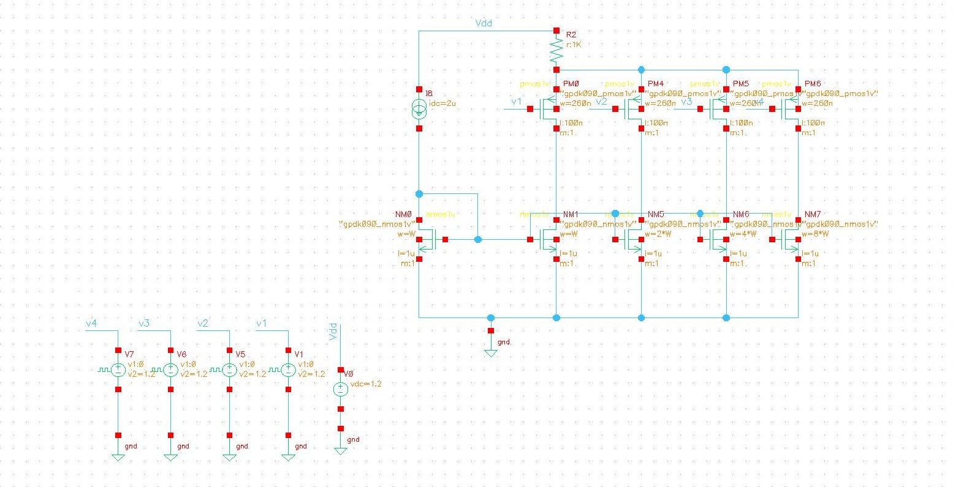
Title: Current steering DAC
Initiation of implementation :
4 bit CS-DAC using PMOS switches :
3/18/23
School of ECE

Slide 20
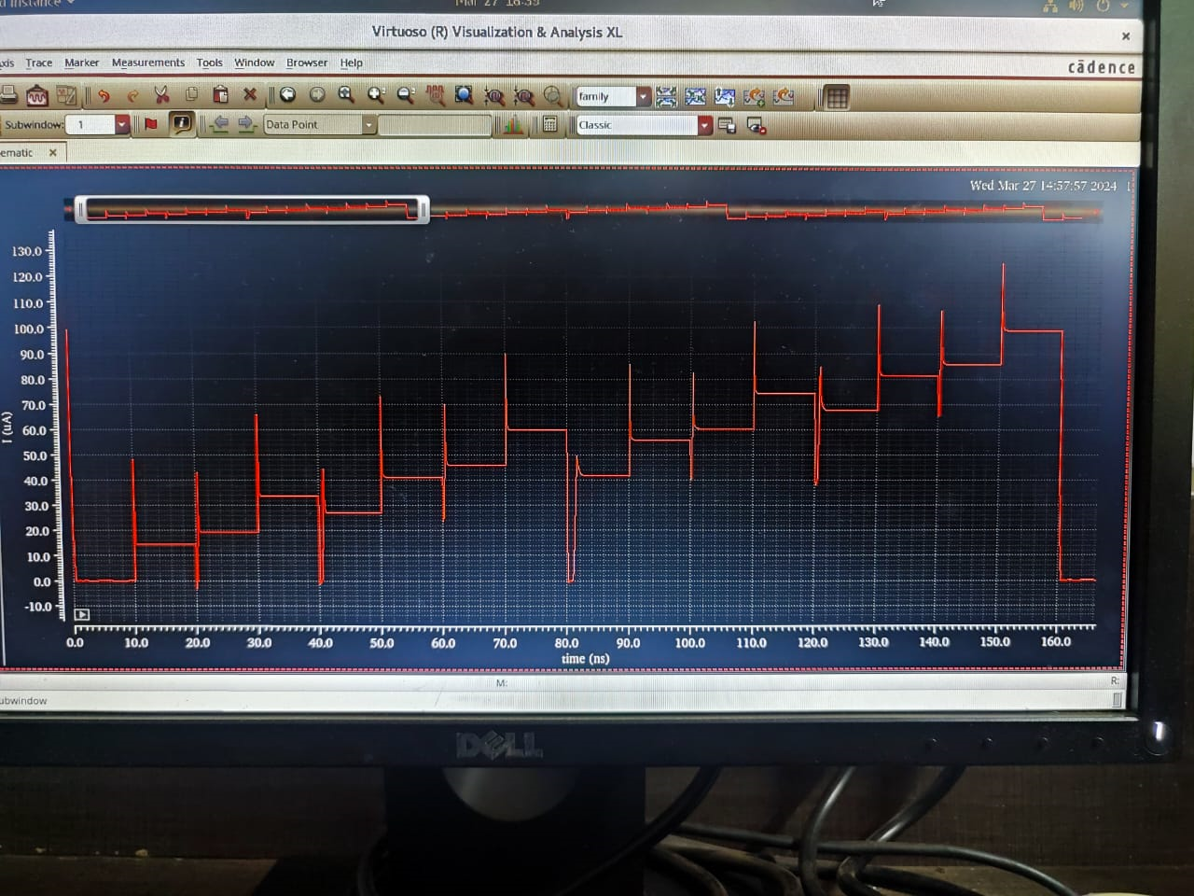
Title: Current steering DAC
4 bit CS-DAC using PMOS switches :
Results:
3/18/23
School of ECE

Slide 21
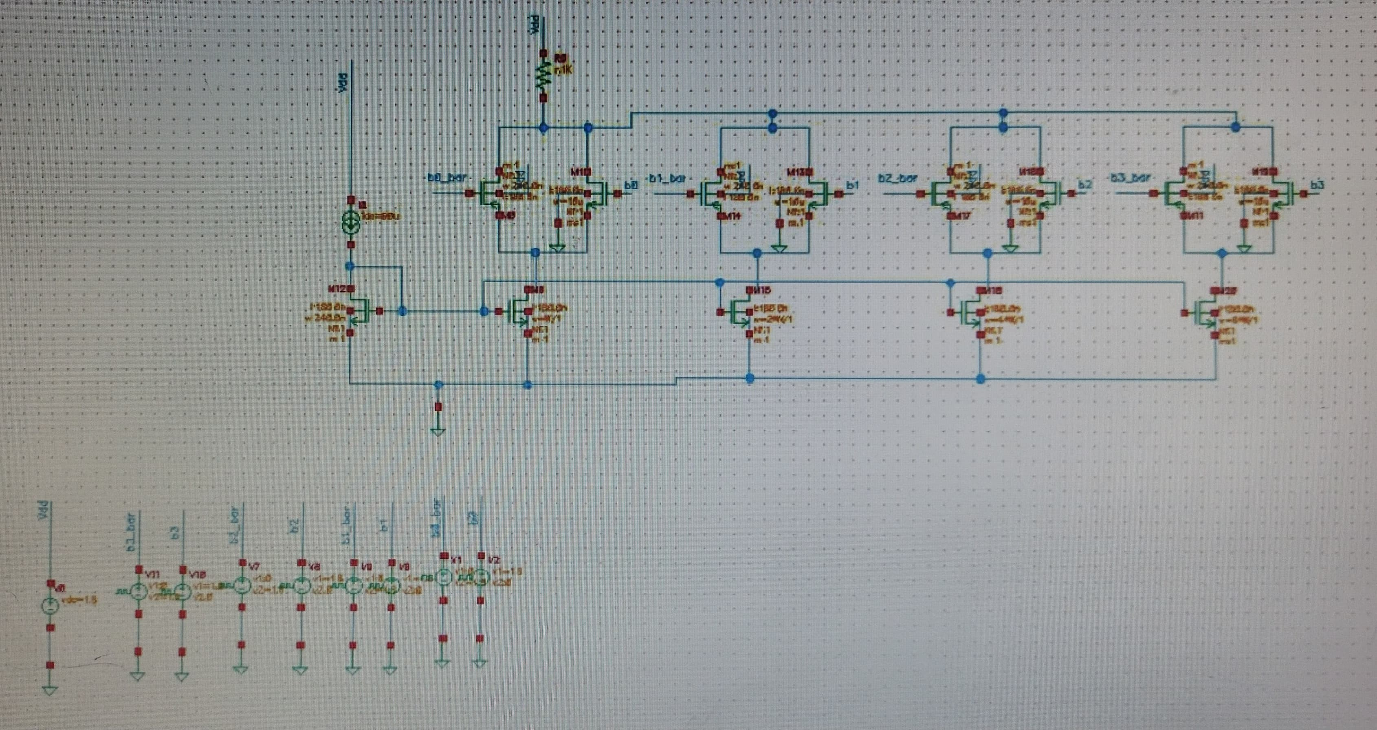
Title: Current steering DAC
4 bit CS-DAC using TG :
3/18/23
School of ECE

Slide 22
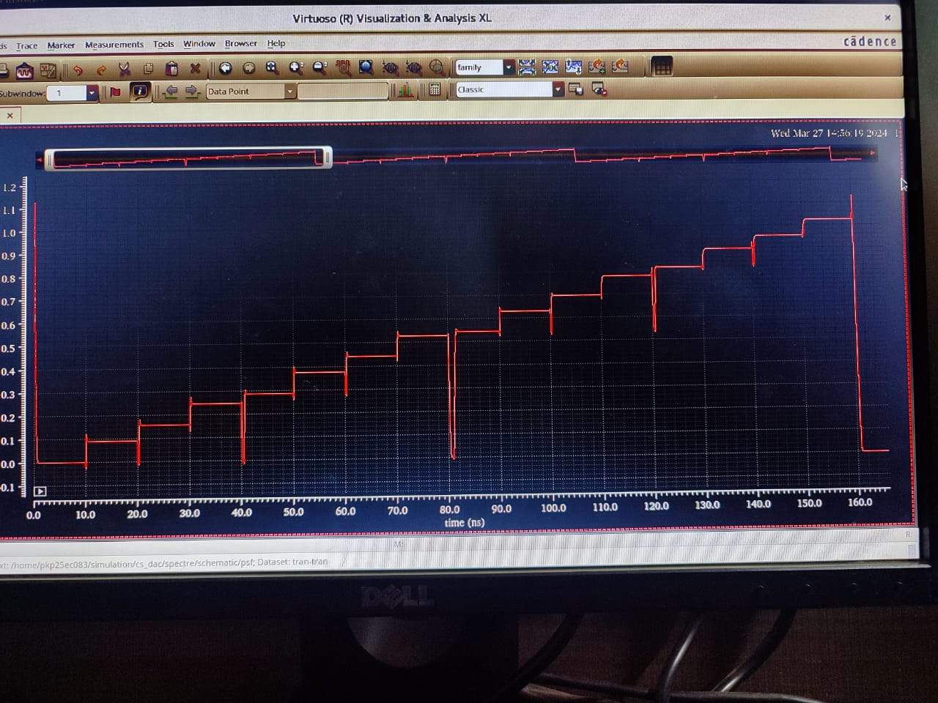
Title: Current steering DAC
4 bit CS-DAC using TG :
Results:
3/18/23
School of ECE

Slide 23
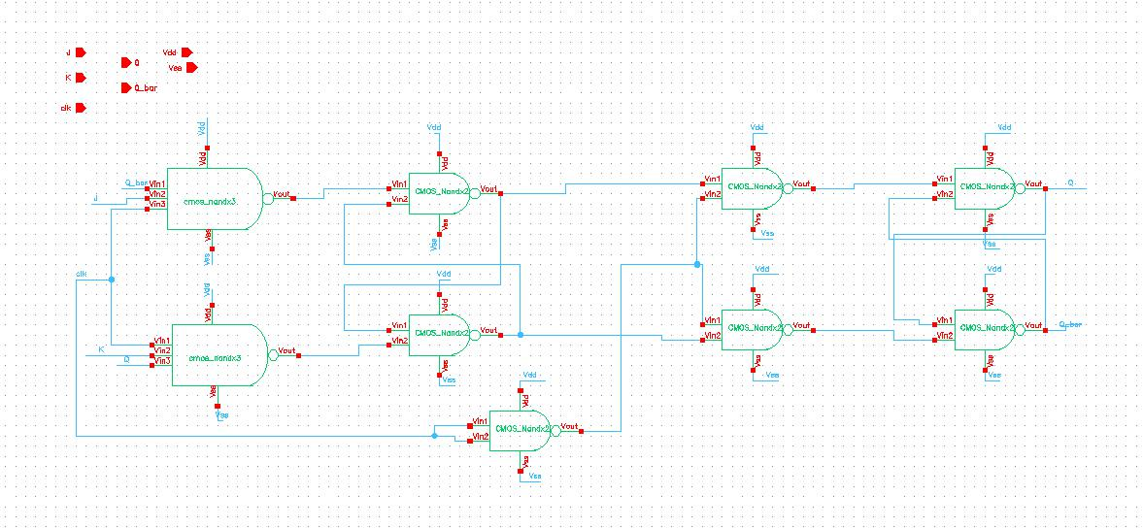
Title: Current steering DAC
JK flipflop:
3/18/23
School of ECE

Slide 24
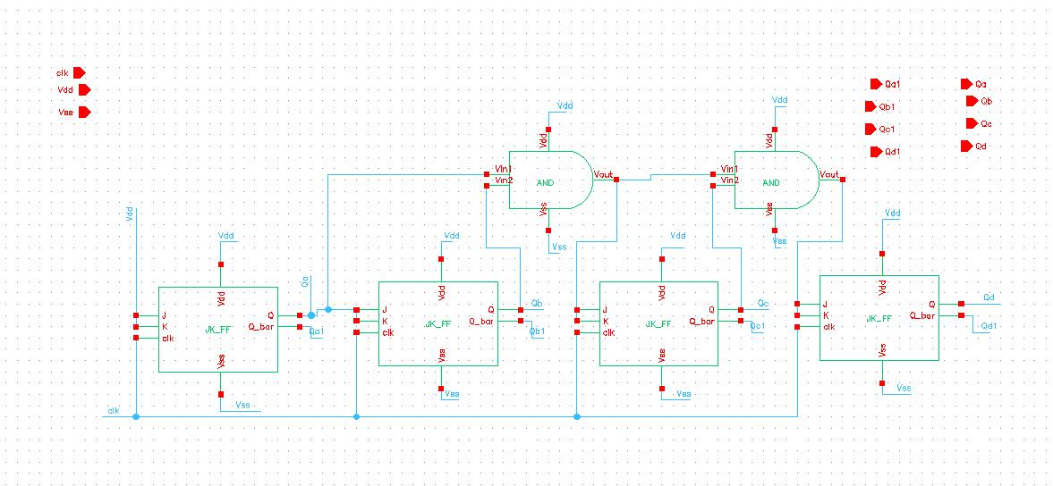
Title: Current steering DAC
4 bit counter using JK flipflop:
3/18/23
School of ECE

Slide 25
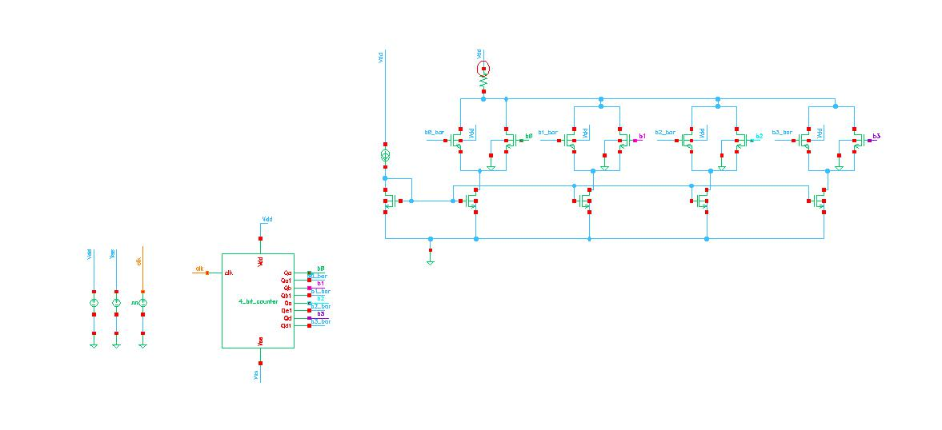
Title: Current steering DAC
4 bit CS DAC using counter :
3/18/23
School of ECE

Slide 26
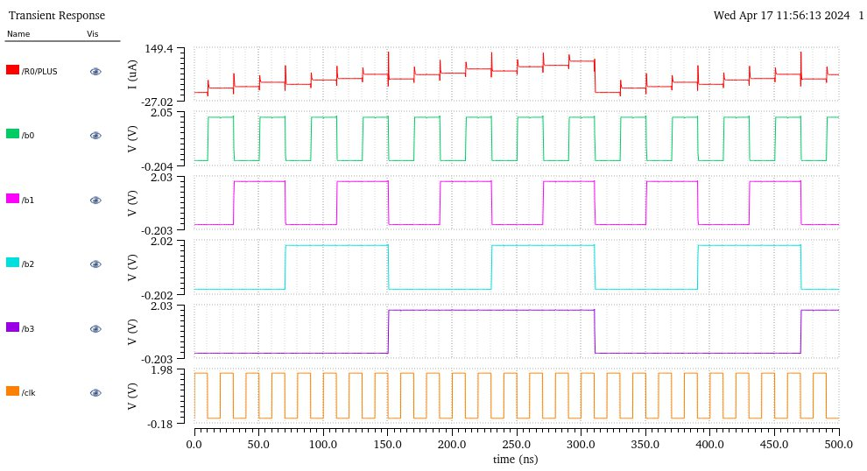
Title: Current steering DAC
4 bit CS DAC using counter :
Results :
3/18/23
School of ECE

Slide 27
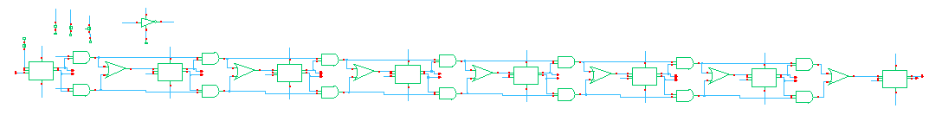
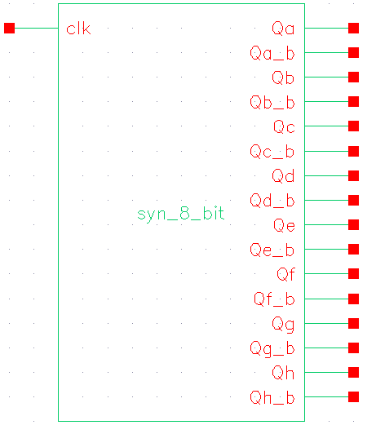
Title: Current steering DAC
8 bit counter :
Schematic :
Symbol :
3/18/23
School of ECE

Slide 28
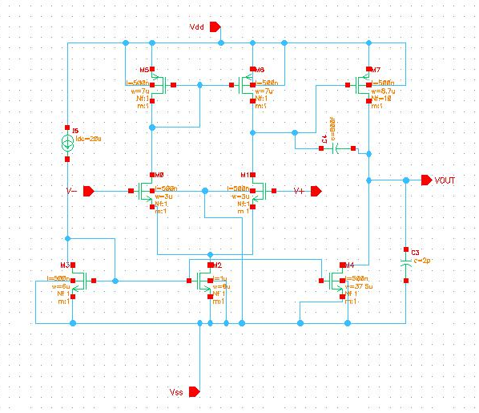
Title: Current steering DAC
Two stage amplifier design :
3/18/23
School of ECE

Slide 29
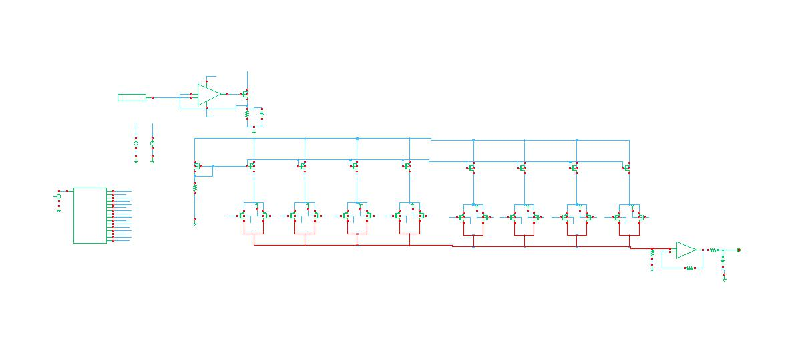
Title: Current steering DAC
8 bit CS-DAC using TG :
3/18/23
School of ECE

Slide 30
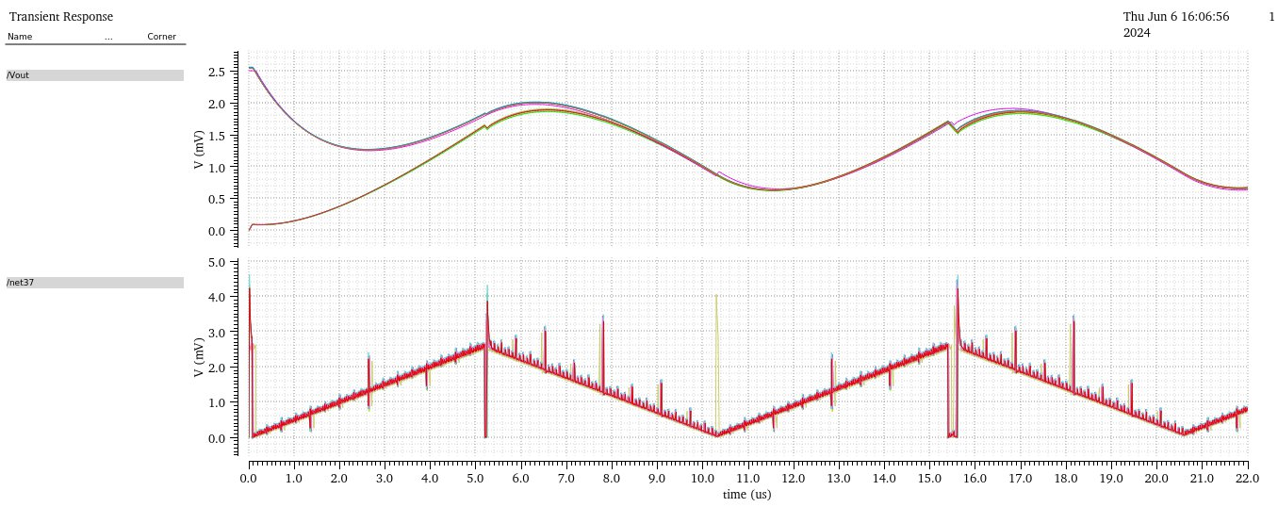
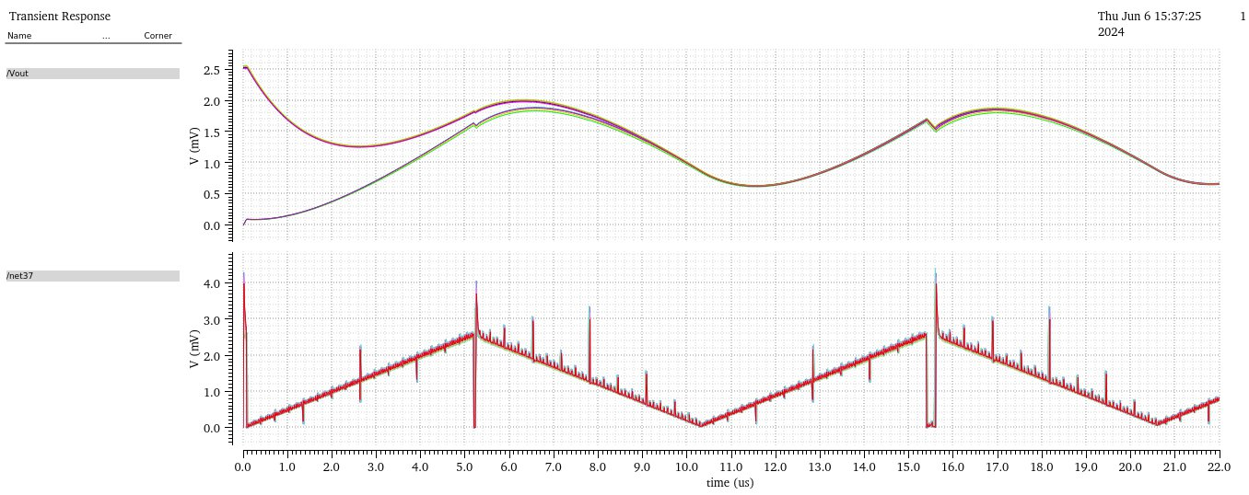
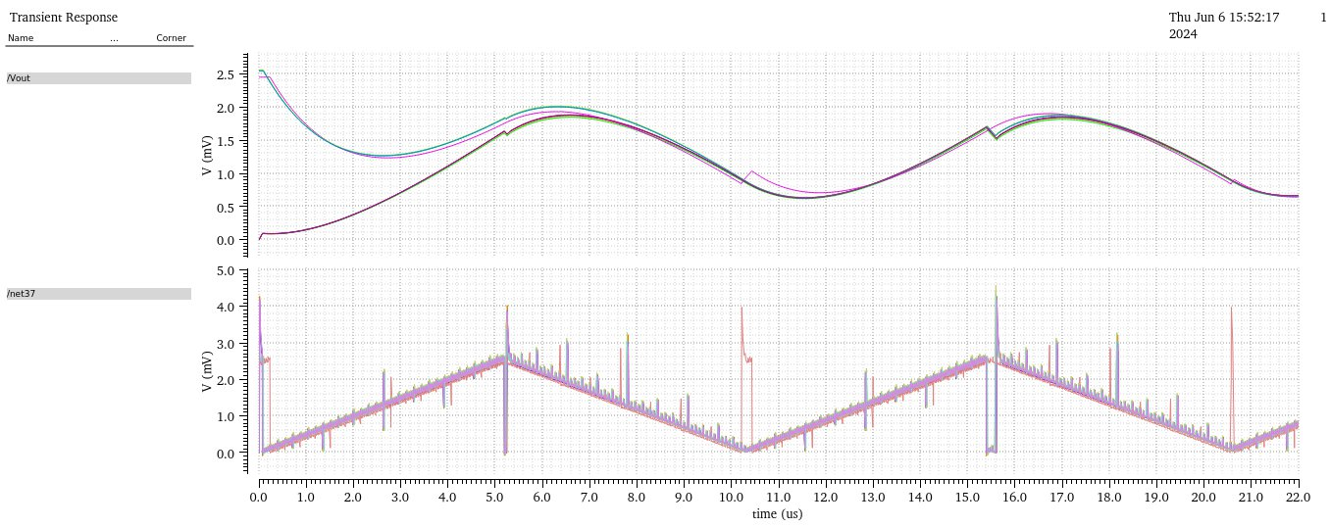
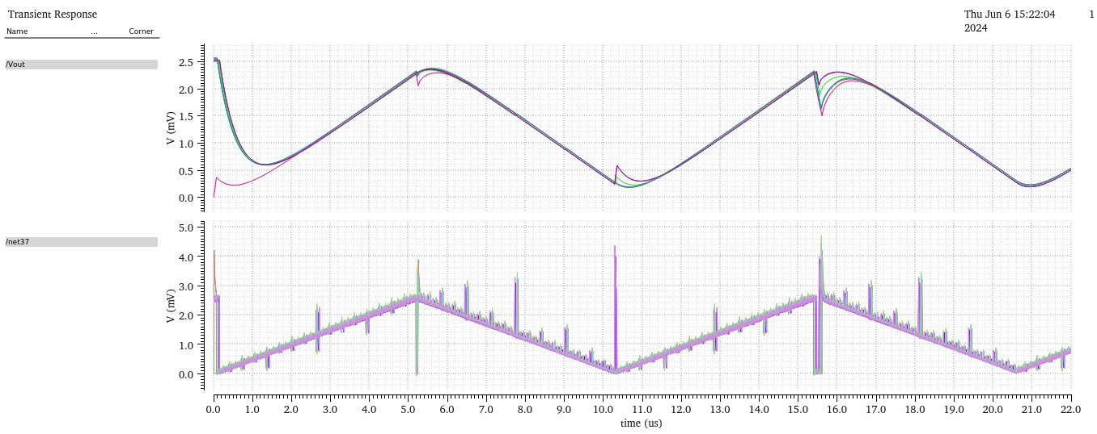
Title: Current steering DAC
PVT analysis of CS-DAC :
3/18/23
School of ECE

Slide 31
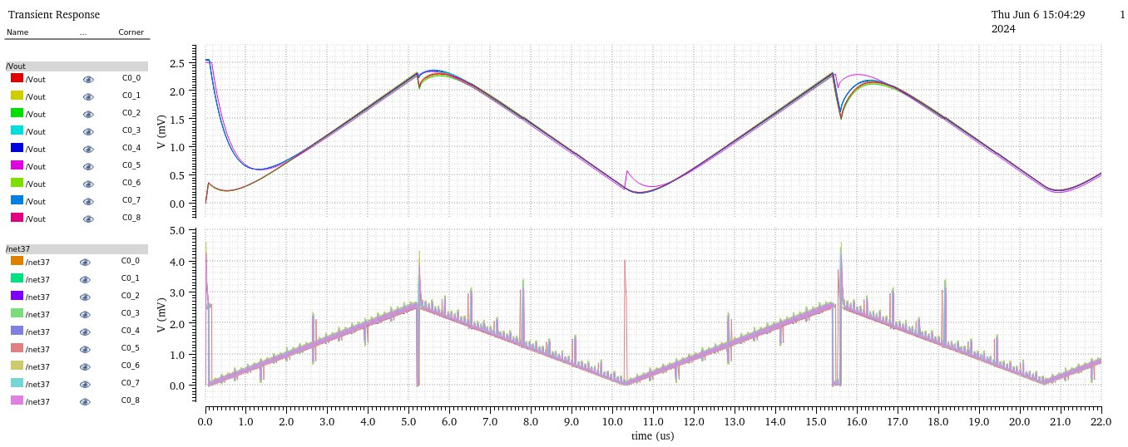
Title: Current steering DAC
PVT analysis of CS-DAC :
3/18/23
School of ECE

Slide 32
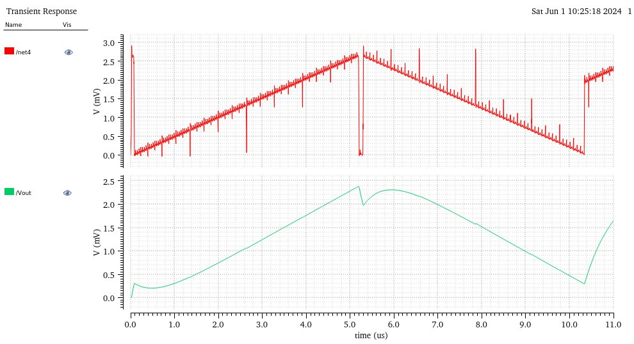
Title: Current steering DAC
Transient analysis of CS-DAC :
3/18/23
School of ECE

Slide 33
Title: Current steering DAC
Conclusion :
Successfully designed and simulated an 8-bit DAC using Virtuoso 6.1.6 and UMC180nm technology.
Used transmission gates instead of conventional switches for superior performance.
Achieved high precision and low sensitivity to process variations.
Met project requirements with a monotonic transfer curve for all digital inputs [00000000] to [11111111].
Observed slight gain variation only for higher digital words above [10101010].
Enhanced linearity and noise rejection compared to conventional resistor-based designs.
Contributed valuable insights to data converter design.
3/18/23
School of ECE

Slide 34
Title: Current steering DAC
Thank you
3/18/23
School of ECE

